Slide 1
HTML

Slide 2

Document Fragments
It is possible to link to a specific part of an HTML document (known as a document fragment), rather than just to the top of the document.
To do this you first have to assign an id attribute to the element you want to link to.
It normally makes sense to link to a specific heading, so this would look something like the following:
Then to link to that specific id, you'd include it at the end of the URL, preceded by a hash/pound symbol, for example:

Slide 3
Document Fragments
You can even use the document fragment reference on its own to link to another part of the same document:

Slide 4
Absolute vs. Relative URL
Two terms you'll come across on the Web are absolute URL and relative URL:
Absolute URL:
Points to a location defined by its absolute location on the web, including protocol and domain name.
So for example, if an index.html page is uploaded to a directory called projects that sits inside the root of a web server, and the web site's domain is http://www.example.com, the page would be available at http://www.example.com/projects/index.html

Slide 5
Absolute vs. Relative URL
Two terms you'll come across on the Web are absolute URL and relative URL:
Relative URL:
Points to a location that is relative to the file you are linking from, more like what we looked at in the previous section.
For example, if we wanted to link from our example file at http://www.example.com/projects/index.html to a PDF file in the same directory, the URL would just be the filename — e.g. project-brief.pdf — no extra information needed.

Slide 6
Description lists
Description lists.
The purpose of these lists is to mark up a set of items and their associated descriptions, such as terms and definitions, or questions and answers .
Description lists use a different wrapper than the other list types — <dl>; in addition each term is wrapped in a <dt> (description term) element, and each description is wrapped in a <dd> (description definition) element.

Slide 7
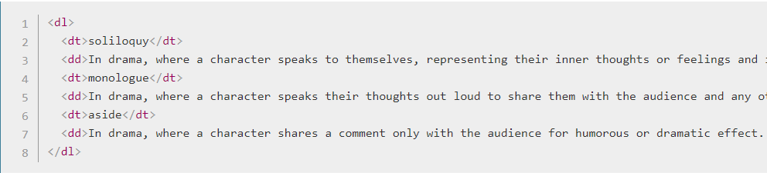
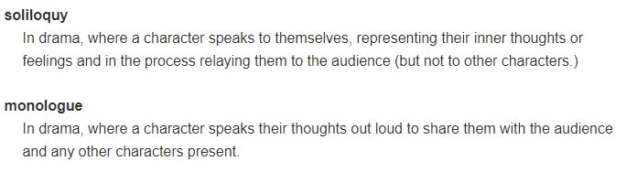
Description lists
Description lists.
Example:
Will appear as:

Slide 8
Activity

Slide 9
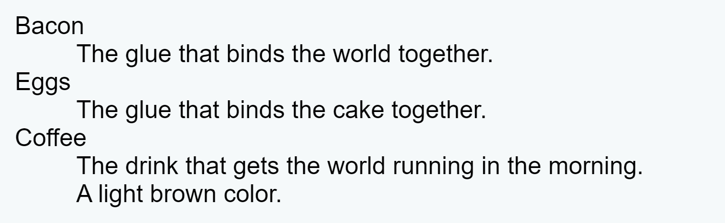
Activity
Add description lists elements so as to get the following output:

Slide 10
Document and Website Structure

Slide 11
Basic sections of a document
Header:
Usually a big strip across the top with a big heading and/or logo.
This is where the main common information about a website usually stays from one webpage to another.
Navigation bar:
Links to the site's main sections; usually represented by menu buttons, links, or tabs. Like the header, this content usually remains consistent from one webpage to another
Main content:
A big area in the center that contains most of the unique content of a given webpage, for example, the video you want to watch, or the main story you're reading

Slide 12
Basic sections of a document
Sidebar:
Some peripheral info, links, quotes, ads, etc.
Usually, this is contextual to what is contained in the main content (for example on a news article page, the sidebar might contain the author's bio, or links to related articles) but there are also cases where you'll find some recurring elements like a secondary navigation system.
Footer:
A strip across the bottom of the page that generally contains fine print, copyright notices, or contact info.
It's a place to put common information (like the header) but usually, that information is not critical or secondary to the website itself.

Slide 13
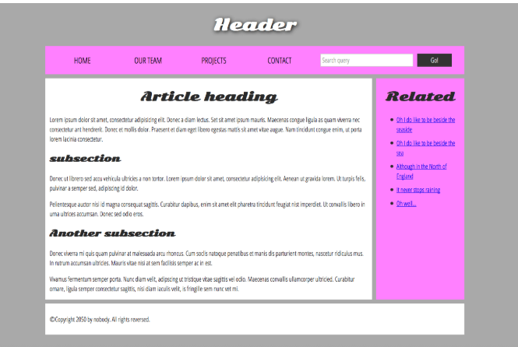
Basic sections of a document
A typical website sections

Slide 14
HTML for structuring content
To implement such semantic mark up, HTML provides dedicated tags that you can use to represent such sections, for example:
Header: <header>.
Navigation bar: <nav>
Main content: <main>, with various content subsections represented by <article>, <section>, and <div> elements.
Sidebar: <aside>; often placed inside <main>.
Footer: <footer>.

Slide 15
HTML layout elements in detail
<main> is for content unique to this page.
Use <main> only once per page, and put it directly inside <body>.
Ideally this shouldn't be nested within other elements.
<article> encloses a block of related content that makes sense on its own without the rest of the page (e.g., a single blog post).
<section> is similar to <article>, but it is more for grouping together a single part of the page that constitutes one single piece of functionality (e.g., a mini map, or a set of article headlines and summaries).
It's considered best practice to begin each section with a heading; also note that you can break <article>s up into different <section>s, or <section>s up into different <article>s, depending on the context.

Slide 16
HTML layout elements in detail
<aside> contains content that is not directly related to the main content but can provide additional information indirectly related to it (glossary entries, author biography, related links, etc.).
<header> represents a group of introductory content.
If it is a child of <body> it defines the global header of a webpage, but if it's a child of an <article> or <section> it defines a specific header for that section (try not to confuse this with titles and headings).
<nav> contains the main navigation functionality for the page.
Secondary links, etc., would not go in the navigation.
<footer> represents a group of end content for a page.

Slide 17
Non-sematic wrappers
Sometimes you'll come across a situation where you can't find an ideal semantic element to group some items together or wrap some content
Sometimes you might want to just group a set of elements together to affect them all as a single entity with some CSS or JavaScript.
For cases like these, HTML provides the <div> and <span> elements.
You should use these preferably with a suitable class attribute, to provide some kind of label for them so they can be easily targeted.

Slide 18
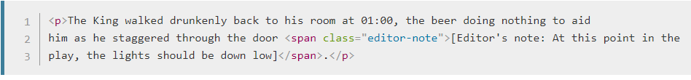
Non-sematic wrappers
<span> is an inline non-semantic element, which you should only use if you can't think of a better semantic text element to wrap your content, or don't want to add any specific meaning. For example:

Slide 19
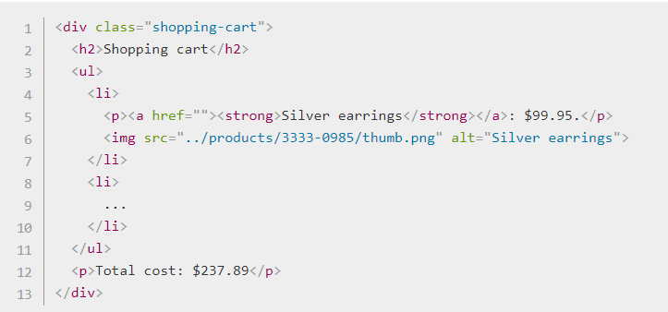
Non-sematic wrappers
<div> is a block level non-semantic element, which you should only use if you can't think of a better semantic block element to use, or don't want to add any specific meaning.

Slide 20
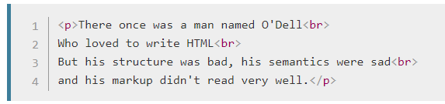
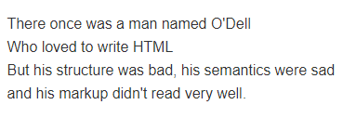
Line breaks and horizontal rules
Two elements that you'll use occasionally and will want to know about are <br> and <hr>:
<br> creates a line break in a paragraph; it is the only way to force a rigid structure in a situation where you want a series of fixed short lines, such as in a postal address or a poem. For example:
Without the <br> elements, the paragraph would just be rendered in one long line
with <br> elements in the code, the markup renders like this:

Slide 21
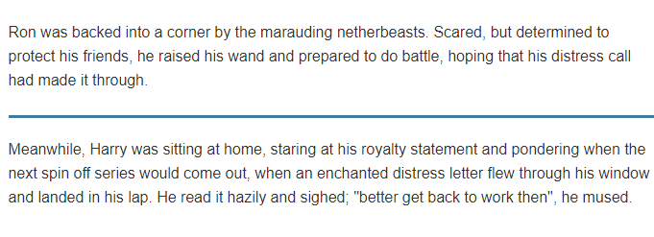
Line breaks and horizontal rules
<hr> elements create a horizontal rule in the document that denotes a thematic change in the text (such as a change in topic or scene). Visually it just looks like a horizontal line. As an example:
Would render like this:

Slide 22
HTML Tables

Slide 23
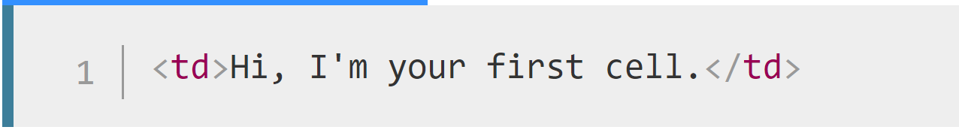
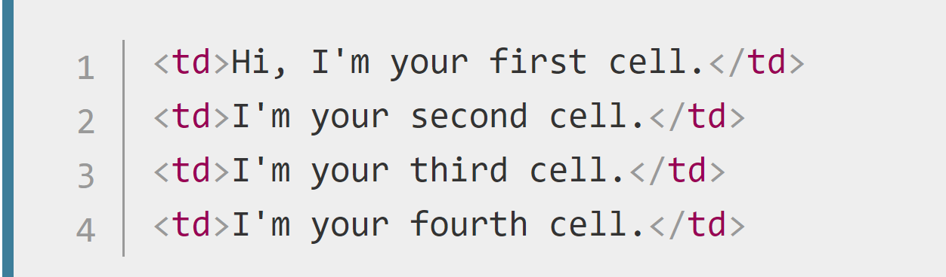
HTML tables
A table is a structured set of data made up of rows and columns (tabular data).
The content of every table is enclosed by these two tags : <table></table>.
The smallest container inside a table is a table cell, which is created by a <td> element ('td' stands for 'table data').
If we want a row of four cells, we need to copy these tags three times.

Slide 24
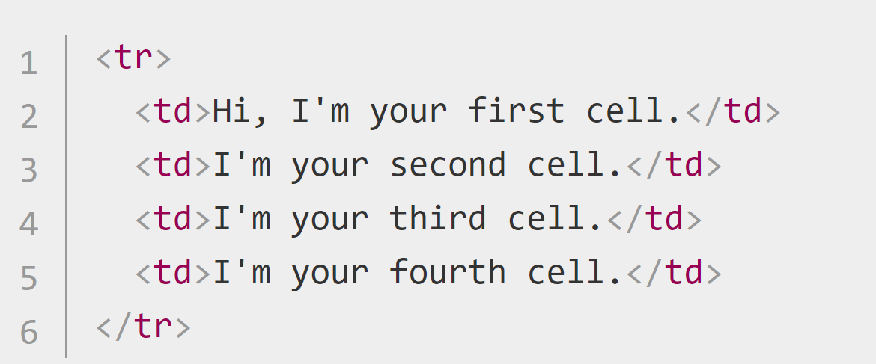
HTML tables
Each <td> element creates a single cell and together they make up the first row. Every cell we add makes the row grow longer.
To stop this row from growing and start placing subsequent cells on a second row, we need to use the <tr> element ('tr' stands for 'table row').

Slide 25
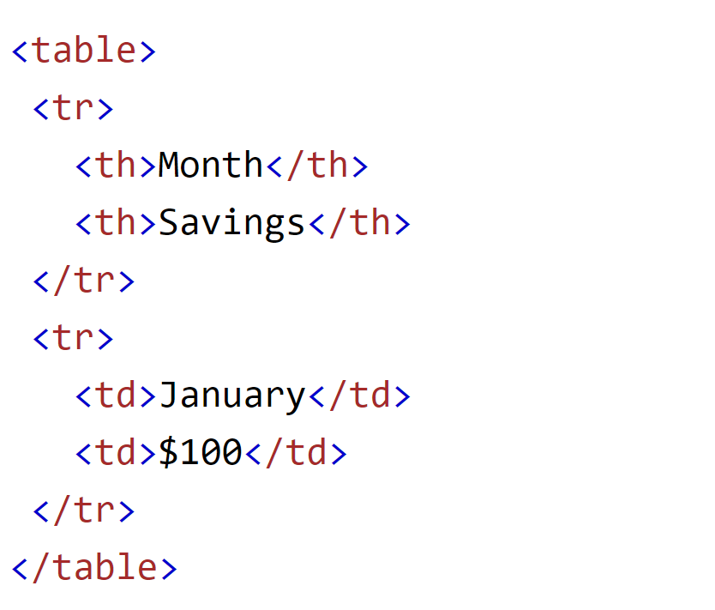
HTML tables
Adding headers with <th>
table headers — special cells that go at the start of a row or column and define the type of data that row or column contains

Slide 26
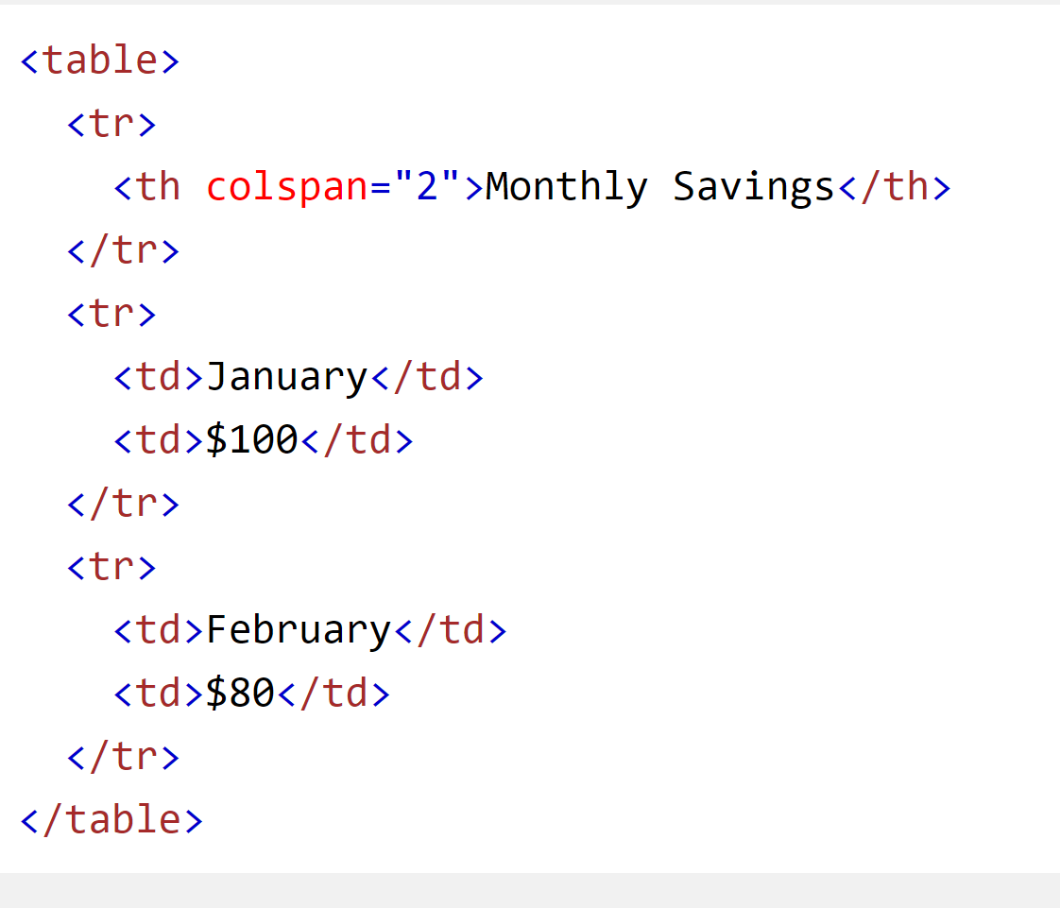
HTML tables
Allowing cells to span multiple rows and columns
Table headers and cells have the colspan and rowspan attributes,
Both accept a unitless number value, which equals the number of rows or columns you want spanned. For example, colspan="2" makes a cell span two columns.

Slide 27
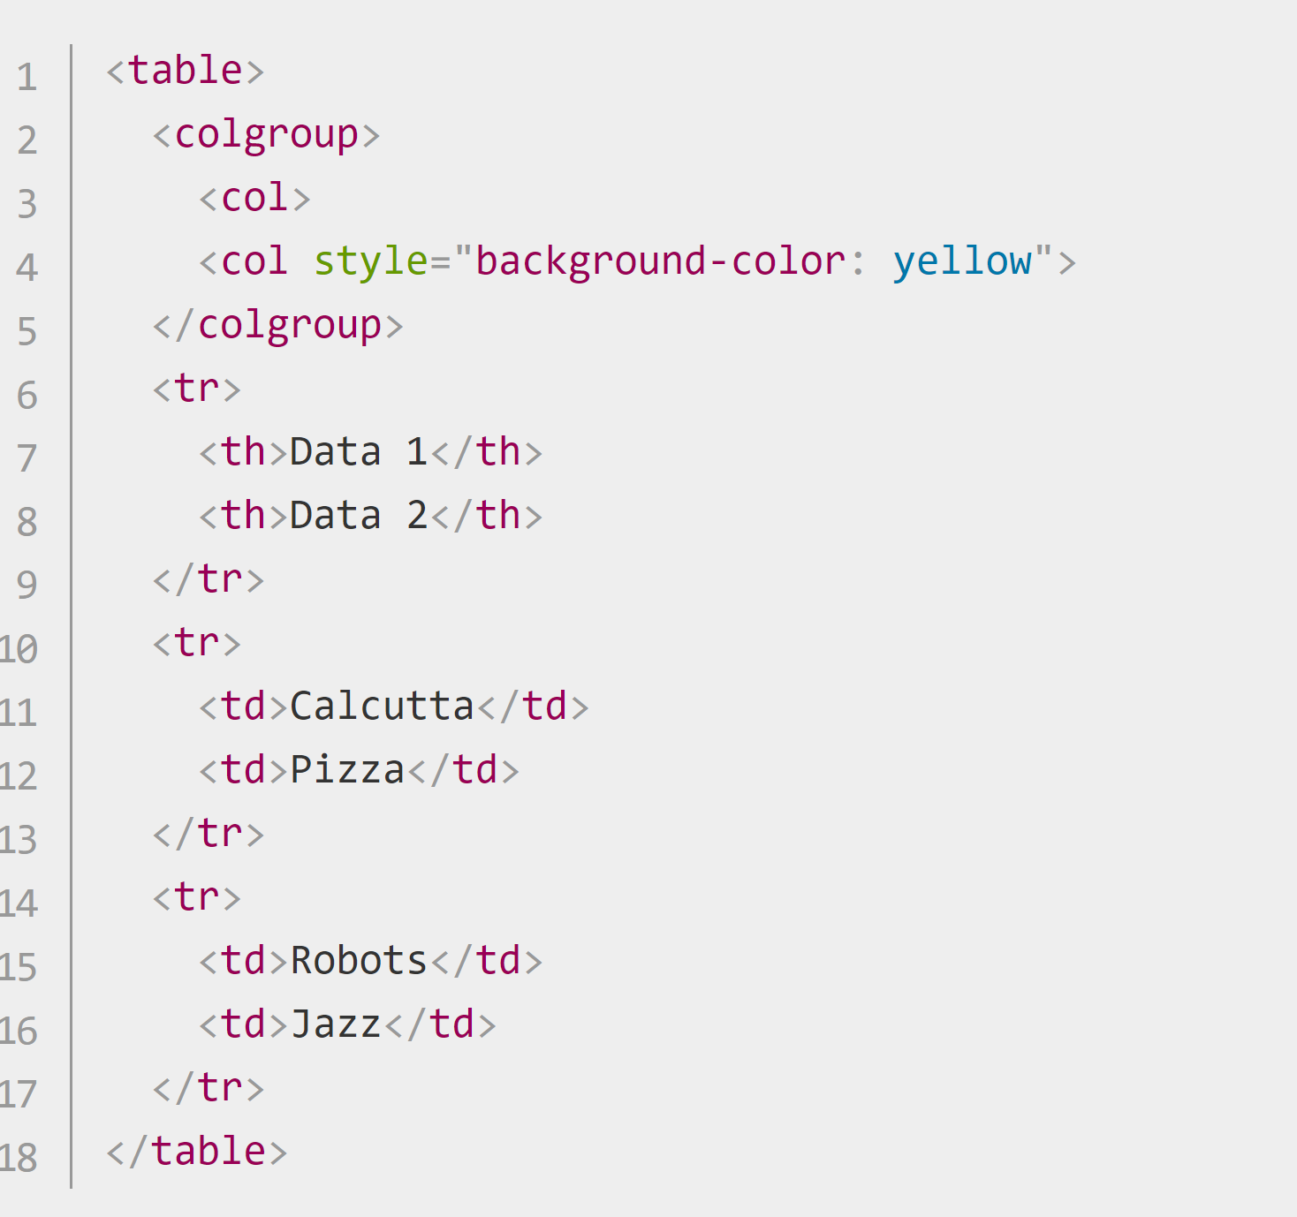
HTML tables
Providing common styling to columns
HTML has a method of defining styling information for an entire column of data all in one place — the <col> and <colgroup> elements.
<col> elements are specified inside a <colgroup> container just below the opening <table> tag.

Slide 28
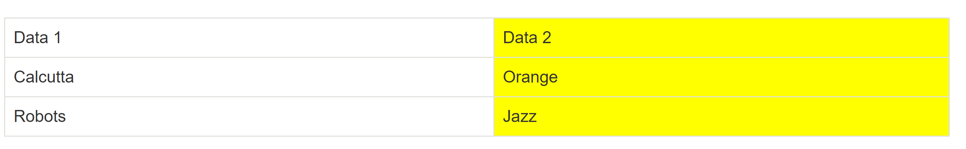
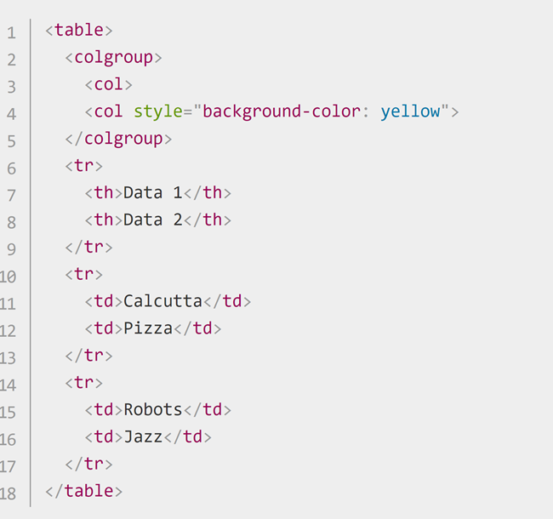
HTML tables
We are not styling the first column, but we still have to include a blank <col> element — if we didn't, the styling would just be applied to the first column also.

Slide 29
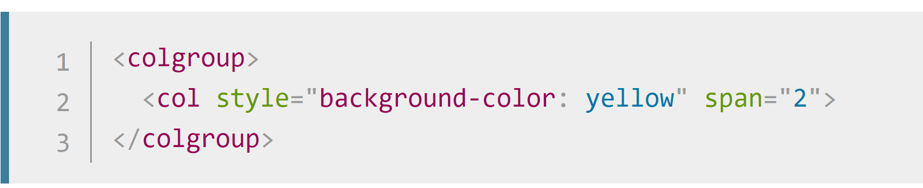
HTML tables
We are not styling the first column, but we still have to include a blank <col> element — if we didn't, the styling would just be applied to the first column also.
If we wanted to apply the styling information to both columns, we could just include one <col> element with a span attribute on it, like this:
Just like colspan and rowspan, span takes a unitless number value that specifies the number of columns you want the styling to apply to.

Slide 30
Activity

Slide 31
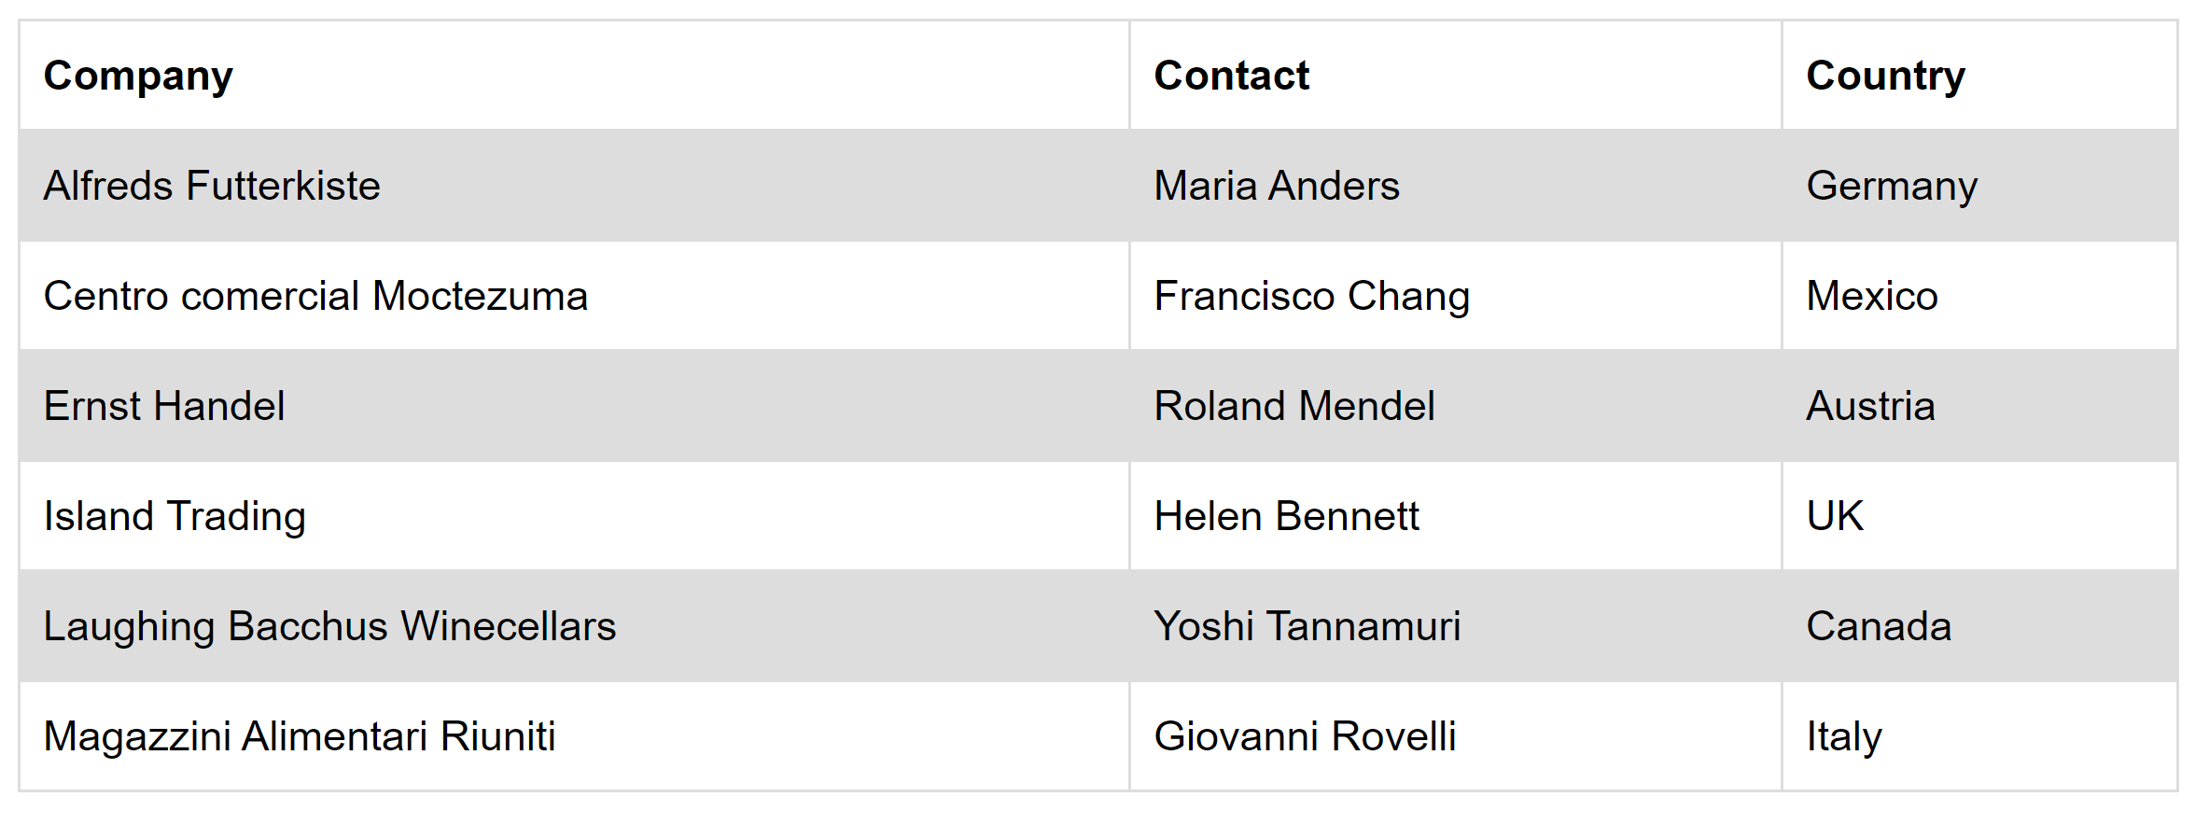
HTML tables- Activity
Write table elements that will give the following output

Slide 32
HTML Forms

Slide 33
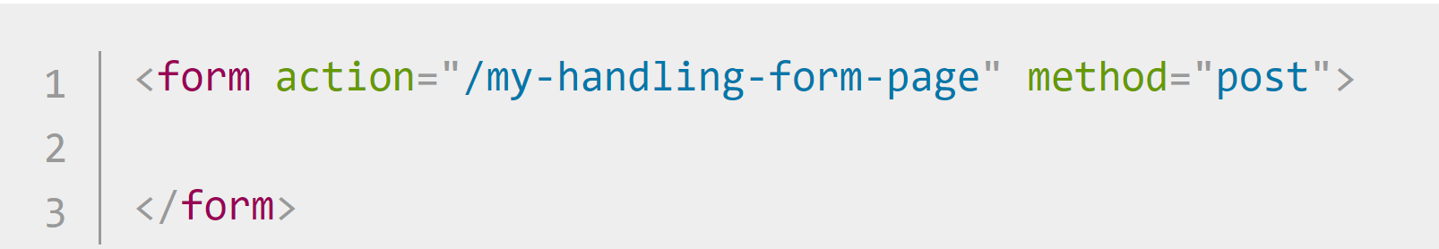
HTML Forms
To create a HTML form, we will use the following HTML elements: <form>, <label>, <input>, <textarea>, and <button>
All forms start with a <form> element, like this:
The action attribute defines the location (URL) where the form's collected data should be sent when it is submitted.
The method attribute defines which HTTP method to send the data with (usually get or post).

Slide 34

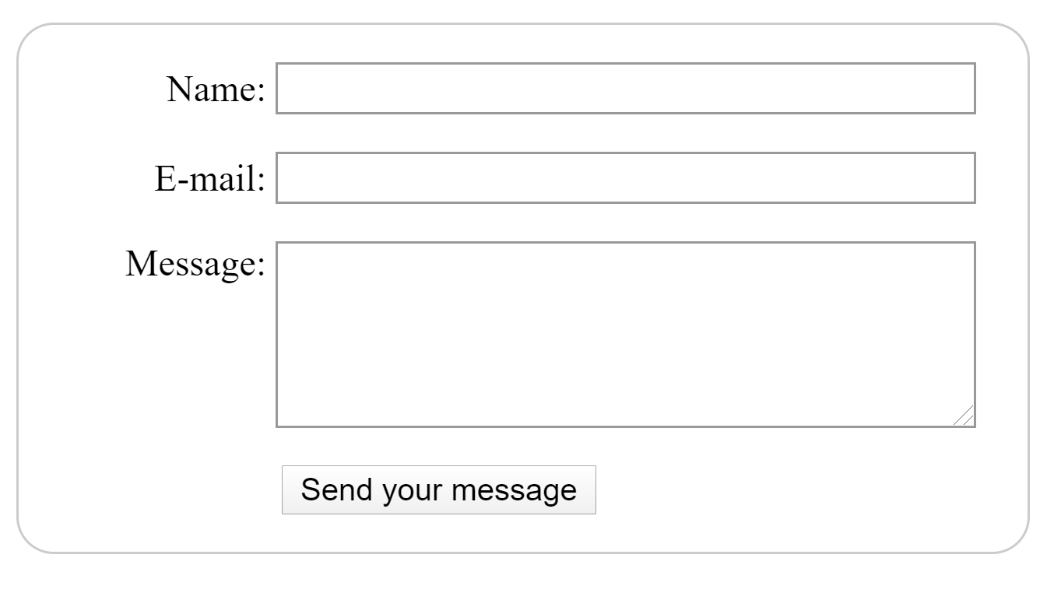
HTML Forms
Our contact form is not complex: the data entry portion contains three text fields, each with a corresponding <label>:

Slide 35
HTML Forms
The input field for the name is a single-line text field.
The input field for the e-mail is an input of type email: a single-line text field that accepts only e-mail addresses.
The input field for the message is a <textarea>; a multiline text field.

Slide 36
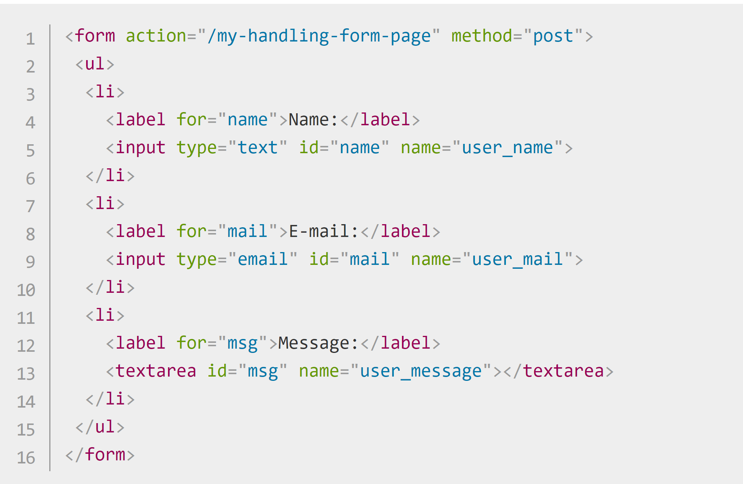
HTML Forms
The <li> elements are there to conveniently structure our code and make styling easier

Slide 37
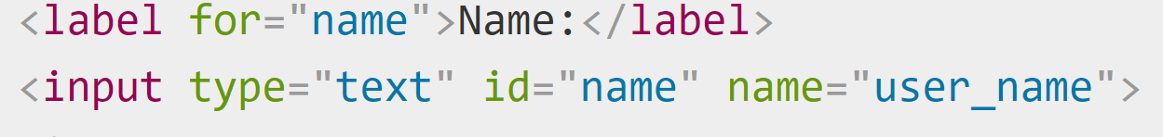
HTML Forms
Note the use of the for attribute on all <label> elements, which takes as its value the id of the form control with which it is associated — this is how you associate a form with its label.

Slide 38
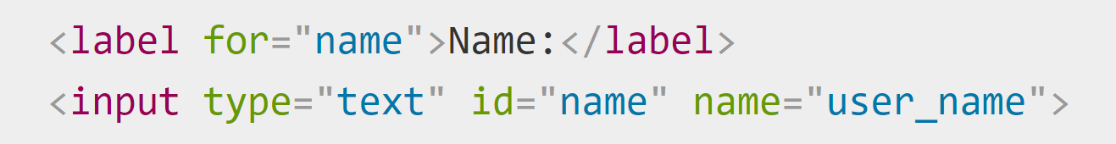
HTML Forms
On the <input> element, the most important attribute is the type attribute. This attribute is extremely important because it defines the way the <input> element appears and behaves.
In our simple example, we use the value <input/text> for the first input — the default value for this attribute.
It represents a basic single-line text field that accepts any kind of text input.

Slide 39
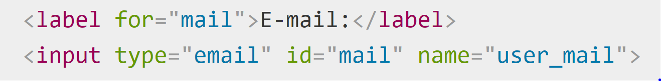
HTML Forms
For the second input, we use the value <input/email>, which defines a single-line text field that only accepts a well-formed e-mail address

Slide 40
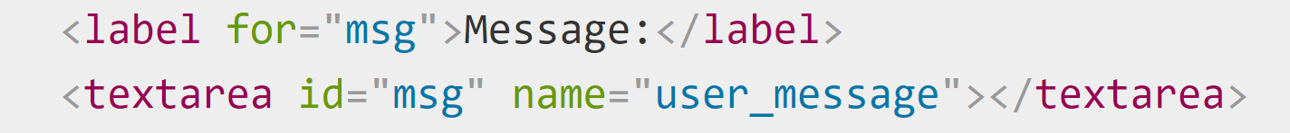
HTML Forms
Note the syntax of <input> vs. <textarea></textarea>.
This is one of the oddities of HTML. The <input> tag is an empty element, meaning that it doesn't need a closing tag.
<textarea> is not an empty element, meaning it should be closed it with the proper ending tag

Slide 41
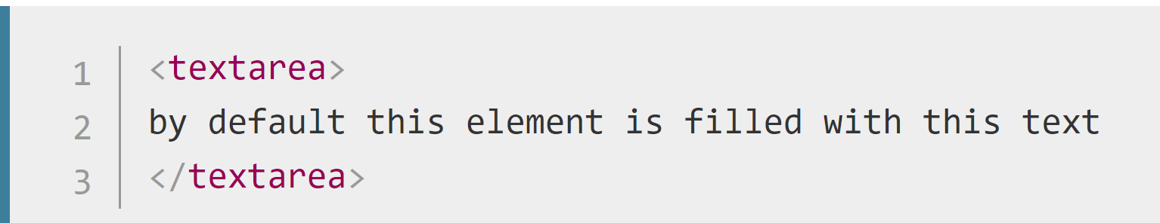
HTML Forms
Default Values
To define the default value of an <input> element you have to use the value attribute like this:
On the other hand, if you want to define a default value for a <textarea>, you put it between the opening and closing tags of the <textarea> element, like this:

Slide 42
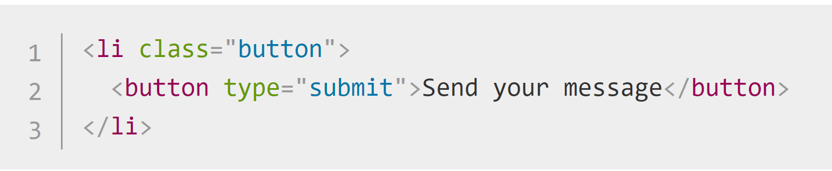
HTML Forms
Button Element
Add a button to allow the user to send, or "submit", their data once they have filled out the form.
This is done by using the <button> element; add the following just above the closing </form> tag:

Slide 43
HTML Forms
Button Element
The <button> element also accepts a type attribute — this accepts one of three values: submit, reset, or button.
A click on a submit button (the default value) sends the form's data to the web page defined by the action attribute of the <form> element.
A click on a reset button resets all the form widgets to their default value immediately. From a UX point of view, this is considered bad practice, so you should avoid using this type of button unless you really have a good reason to include one.

Slide 44
HTML Forms
Button Element
The <button> element also accepts a type attribute — this accepts one of three values: submit, reset, or button.
A click on a button button does... nothing! That sounds silly, but it's amazingly useful for building custom buttons — you can define their chosen functionality with JavaScript.
Note: You can also use the <input> element with the corresponding type to produce a button, for example <input type="submit">.
The main advantage of the <button> element is that the <input> element only allows plain text in its label whereas the <button> element allows full HTML content, allowing more complex, creative button content.

Slide 45
Activity

Slide 46
Questions

